Slide 1
Data Mining
Chapter 5
Association Analysis: Basic Concepts

Slide 2
Market Basket Transaction
Many business enterprises accumulate large quantities of data from their day-to-day operations. For example, huge amounts of customer purchase data are collected daily at the checkout counters of grocery stores. Such data, is commonly known as market basket transactions.
Each row in this table corresponds to a transaction, which contains a unique identifier labeled TID and a set of items bought by a given customer. Retailers are interested in analyzing the data to learn about the purchasing behavior of their customers.
Notes:
Such valuable information can be used to support a variety of business-related applications such as marketing promotions, inventory management, and customer relationship management.

Slide 3
Association Rule Mining
Given a set of transactions, find rules that will predict the occurrence of an item based on the occurrences of other items in the transaction
Market-Basket transactions
Example of Association Rules
{Diaper} → {Beer}, {Milk, Bread} → {Eggs,Coke}, {Beer, Bread} → {Milk},
Implication means co-occurrence, not causality!
Notes:
The rule suggests that a strong relationship exists between the sale of diapers
and beer because many customers who buy diapers also buy beer. Retailers
can use this type of rules to help them identify new opportunities for crossselling
their products to the customers.

Slide 4
Issues
There are two key issues that need to be addressed when applying association analysis to market basket data.
First, discovering patterns from a large transaction data set can be computationally expensive.
Second, some of the discovered patterns are potentially spurious because they may happen simply by chance.

Slide 5
Binary Representation
Market basket data can be represented in a binary format where each row corresponds to a transaction and each column corresponds to an item.
An item can be treated as a binary variable whose value is one if the item is present in a transaction and zero otherwise. Because the presence of an item in a transaction is often considered more important than its absence, an item is an asymmetric binary variable.
Notes:
If the outcomes of a binary variable are not equally important

Slide 6
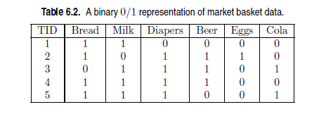
Example
This representation is perhaps a very simplistic view of real market basket data because it ignores certain important aspects of the data such as the quantity of items sold or the price paid to purchase them

Slide 7
Definition
Itemset
A collection of one or more items
Example: {Milk, Bread, Diaper}
k-itemset
An itemset that contains k items
Support count (σ)
Frequency of occurrence of an itemset
E.g. σ({Milk, Bread,Diaper}) = 2
Support
Fraction of transactions that contain an itemset
E.g. s({Milk, Bread, Diaper}) = 2/5
Frequent Itemset
An itemset whose support is greater than or equal to a minsup threshold
Notes:
The null (or empty) set is an itemset that does
not contain any items.

Slide 8
Definition: Association Rule
Association Rule
An implication expression of the form X → Y, where X and Y are itemsets
Example: {Milk, Diaper} → {Beer}
Rule Evaluation Metrics
Support (s)
Fraction of transactions that contain both X and Y
Confidence (c)
Measures how often items in Y appear in transactions that contain X
Example:
Notes:
An association rule is an implication expression of the
form X −→ Y , where X and Y are disjoint itemsets, i.e., X ∩ Y = ∅.
Support, s(X −→ Y) = σ(X ∪ Y )
N
; (6.1)
Confidence, c(X −→ Y) = σ(X ∪ Y )
σ(X) .

Slide 9
Definition
The transaction width is defined as the number of items present in a transaction.
A transaction tj is said to contain an itemset X if X is a subset of tj .

Slide 10
Why use support
Support is an important measure because a rule that has very low support may occur simply by chance. A low support rule is also likely to be uninteresting from a business perspective because it may not be profitable to promote items that customers seldom buy together. For these reasons, support is often used to eliminate uninteresting rules.

Slide 11
Why use confidence
Confidence, on the other hand, measures the reliability of the inference made by a rule. For a given rule X → Y , the higher the confidence, the more likely it is for Y to be present in transactions that contain X. Confidence also provides an estimate of the conditional probability of Y given X.
Notes:
Association analysis results should be interpreted with caution. The inference
made by an association rule does not necessarily imply causality. Instead,
it suggests a strong co-occurrence relationship between items in the antecedent
and consequent of the rule. Causality, on the other hand, requires knowledge
about the causal and effect attributes in the data and typically involves relationships
occurring over time (e.g., ozone depletion leads to global warming).

Slide 12
Caution
Association analysis results should be interpreted with caution. The inference made by an association rule does not necessarily imply causality. Instead, it suggests a strong co-occurrence relationship between items in the antecedent and consequent of the rule. Causality, on the other hand, requires knowledge about the causal and effect attributes in the data and typically involves relationships occurring over time (e.g., ozone depletion leads to global warming).

Slide 13
Association Rule Mining Task
Given a set of transactions T, the goal of association rule mining is to find all rules having
support ≥ minsup threshold
confidence ≥ minconf threshold
Brute-force approach:
List all possible association rules
Compute the support and confidence for each rule
Prune rules that fail the minsup and minconf thresholds
⇒ Computationally prohibitive!

Slide 14
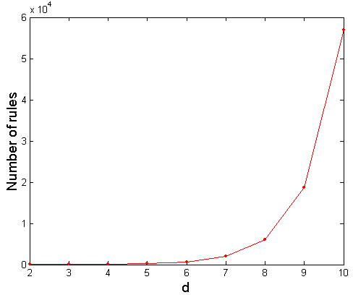
Computational Complexity
Given d unique items:
Total number of itemsets = 2^{d}
Total number of possible association rules:
If d=6, R = 602 rules
Notes:
More than 80% of the rules are discarded after applying minsup = 20% and
minconf = 50%, thus making most of the computations become wasted. To
avoid performing needless computations, it would be useful to prune the rules
early without having to compute their support and confidence values.

Slide 15
Example
{Milk,Diaper} → {Beer}
{Milk,Beer} → {Diaper}
{Diaper,Beer} → {Milk}
{Beer} → {Milk,Diaper}
{Diaper} → {Milk,Beer}
{Milk} → {Diaper,Beer}
Notes:
notice that the support of a rule X −→ Y depends only on
the support of its corresponding itemset, X ∪ Y . For example, the following
rules have identical support because they involve items from the same itemset,
{Beer, Diapers, Milk}:
{Beer, Diapers} −→ {Milk}, {Beer, Milk} −→ {Diapers},
{Diapers, Milk} −→ {Beer}, {Beer} −→ {Diapers, Milk},
{Milk} −→ {Beer,Diapers}, {Diapers} −→ {Beer,Milk}.
If the itemset is infrequent, then all six candidate rules can be pruned immediately
without our having to compute their confidence values.

Slide 16
Mining Association Rules
Example of Rules:
{Milk,Diaper} → {Beer} (s=0.4, c=0.67) {Milk,Beer} → {Diaper} (s=0.4, c=1.0)
{Diaper,Beer} → {Milk} (s=0.4, c=0.67)
{Beer} → {Milk,Diaper} (s=0.4, c=0.67) {Diaper} → {Milk,Beer} (s=0.4, c=0.5)
{Milk} → {Diaper,Beer} (s=0.4, c=0.5)
Observations:
All the above rules are binary partitions of the same itemset: {Milk, Diaper, Beer}
Rules originating from the same itemset have identical support but can have different confidence
Thus, we may decouple the support and confidence requirements
Notes:
{Milk,Diaper} → {Beer} (s=0.4, c=0.67) {Milk,Beer} → {Diaper} (s=0.4, c=1.0)
{Diaper,Beer} → {Milk} (s=0.4, c=0.67)
{Beer} → {Milk,Diaper} (s=0.4, c=0.67) {Diaper} → {Milk,Beer} (s=0.4, c=0.5)
{Milk} → {Diaper,Beer} (s=0.4, c=0.5)

Slide 17
Mining Association Rules
Two-step approach:
Frequent Itemset Generation
Generate all itemsets whose support ≥ minsup
Rule Generation
Generate high confidence rules from each frequent itemset, where each rule is a binary partitioning of a frequent itemset
Frequent itemset generation is still computationally expensive
Notes:
The computational requirements for frequent itemset generation are generally
more expensive than those of rule generation. Efficient techniques for
generating frequent itemsets and association rules are discussed in Sections 6.2
and 6.3, respectively.

Slide 18
Frequent Itemset Generation
Given d items, there are 2^{d} possible candidate itemsets
Notes:
A lattice structure can be used to enumerate the list of all possible itemsets.
Figure 6.1 shows an itemset lattice for I = {a, b, c, d, e}. In general, a data set
that contains k items can potentially generate up to 2k − 1 frequent itemsets,
excluding the null set. Because k can be very large in many practical applications,
the search space of itemsets that need to be explored is exponentially
large.

Slide 19
Frequent Itemset Generation
Brute-force approach:
Each itemset in the lattice is a candidate frequent itemset
Count the support of each candidate by scanning the database
Match each transaction against every candidate
Complexity ~ O(NMw) => Expensive since M = 2^{d} !!!
Notes:
Such an approach can be very expensive because it requires
O(NMw) comparisons, where N is the number of transactions, M = 2k −1 is
the number of candidate itemsets, and w is the maximum transaction width.

Slide 20
Frequent Itemset Generation Strategies
Reduce the number of candidates (M)
Complete search: M=2^{d}
Use pruning techniques to reduce M
Reduce the number of transactions (N)
Reduce size of N as the size of itemset increases
Reduce the number of comparisons (NM)
Use efficient data structures to store the candidates or transactions
No need to match every candidate against every transaction
Notes:
The Apriori principle,
described in the next section, is an effective way to eliminate some
of the candidate itemsets without counting their support values
Instead of matching each candidate
itemset against every transaction, we can reduce the number of
comparisons by using more advanced data structures, either to store the
candidate itemsets or to compress the data set

Slide 21
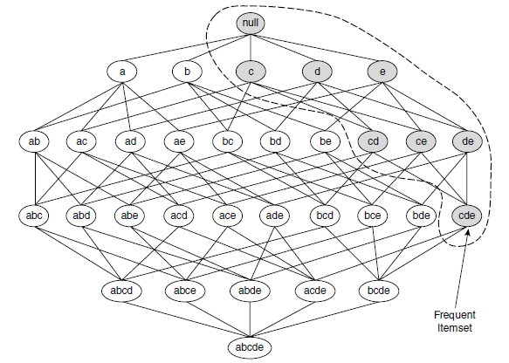
Reducing Number of Candidates
Apriori principle:
If an itemset is frequent, then all of its subsets must also be frequent
Notes:
To illustrate the idea behind the Apriori principle, consider the itemset
lattice shown in Figure 6.3. Suppose {c, d, e} is a frequent itemset. Clearly,
any transaction that contains {c, d, e} must also contain its subsets, {c, d},
{c, e}, {d, e}, {c}, {d}, and {e}. As a result, if {c, d, e} is frequent, then
all subsets of {c, d, e} (i.e., the shaded itemsets in this figure) must also be
frequent.

Slide 22
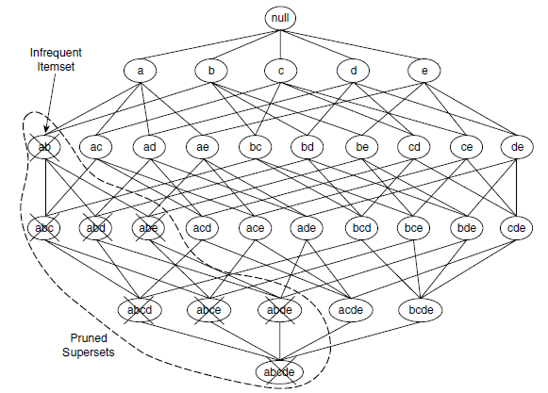
Reducing Number of Candidates
Apriori principle:
Conversely, if an itemset such as {a, b} is infrequent, then all of its supersets must be infrequent too.
Notes:
As illustrated in Figure 6.4, the entire subgraph
containing the supersets of {a, b} can be pruned immediately once {a, b} is
found to be infrequent.

Slide 23
Reducing Number of Candidates
Apriori principle:
This strategy of trimming the exponential search space based on the support measure is known as support-based pruning.
Such a pruning strategy is made possible by a key property of the support measure, namely, that the support for an itemset never exceeds the support for its subsets. This property is also known as the anti-monotone property

Slide 24
Monotone and Antimonotone Property
A measure f is monotone (or upward closed) if
∀X, Y ∈ J : (X ⊆ Y ) → f(X) ≤ f(Y )
which means that if X is a subset of Y, then f(X) must not exceed f(Y ).
f is anti-monotone (or downward closed) if
∀X, Y ∈ J : (X ⊆ Y ) → f(Y ) ≤ f(X)
which means that if X is a subset of Y , then f(Y ) must not exceed f(X).
Notes:
that the support for an itemset never exceeds the support
for its subsets. This property is also known as the anti-monotone property
of the support measure.

Slide 25
Antimonotone
Any measure that possesses an anti-monotone property can be incorporated directly into the mining algorithm to effectively prune the exponential search space of candidate itemsets

Slide 26
Illustrating Apriori Principle
Found to be Infrequent
Pruned supersets

Slide 27
Illustrating Apriori Principle
Found to be Infrequent
Pruned supersets

Slide 28
Illustrating Apriori Principle
Items (1-itemsets)
Minimum Support = 3
If every subset is considered,
⁶C₁ + ⁶C₂ + ⁶C₃
6 + 15 + 20 = 41
With support-based pruning,
6 + 6 + 4 = 16
Notes:
Apriori is the first association rule mining algorithm that pioneered the use
of support-based pruning to systematically control the exponential growth of
candidate itemsets.
We assume that the support threshold is 60%, which is equivalent
to a minimum support count equal to 3.

Slide 29
Illustrating Apriori Principle
Items (1-itemsets)
Pairs (2-itemsets)
(No need to generate candidates involving Coke or Eggs)
Minimum Support = 3
If every subset is considered,
⁶C₁ + ⁶C₂ + ⁶C₃
6 + 15 + 20 = 41
With support-based pruning,
6 + 6 + 4 = 16
Notes:
In the next iteration,
candidate 2-itemsets are generated using only the frequent 1-itemsets because
the Apriori principle ensures that all supersets of the infrequent 1-itemsets
must be infrequent.

Slide 30
Illustrating Apriori Principle
Items (1-itemsets)
Pairs (2-itemsets)
(No need to generate candidates involving Coke or Eggs)
Minimum Support = 3
If every subset is considered,
⁶C₁ + ⁶C₂ + ⁶C₃
6 + 15 + 20 = 41
With support-based pruning,
6 + 6 + 4 = 16

Slide 31
Illustrating Apriori Principle
Items (1-itemsets)
Pairs (2-itemsets)
(No need to generate candidates involving Coke or Eggs)
Minimum Support = 3
Triplets (3-itemsets)
If every subset is considered,
⁶C₁ + ⁶C₂ + ⁶C₃
6 + 15 + 20 = 41
With support-based pruning,
6 + 6 + 4 = 16
If every subset is considered,
⁶C₁ + ⁶C₂ + ⁶C₃
6 + 15 + 20 = 41
With support-based pruning,
6 + 6 + 4 = 16

Slide 32
Illustrating Apriori Principle
Items (1-itemsets)
Pairs (2-itemsets)
(No need to generate candidates involving Coke or Eggs)
Minimum Support = 3
Triplets (3-itemsets)
If every subset is considered,
⁶C₁ + ⁶C₂ + ⁶C₃
6 + 15 + 20 = 41
With support-based pruning,
6 + 6 + 4 = 16

Slide 33
Illustrating Apriori Principle
Items (1-itemsets)
Pairs (2-itemsets)
(No need to generate candidates involving Coke or Eggs)
Minimum Support = 3
Triplets (3-itemsets)
If every subset is considered,
⁶C₁ + ⁶C₂ + ⁶C₃
6 + 15 + 20 = 41
With support-based pruning,
6 + 6 + 4 = 16
6 + 6 + 1 = 13
Notes:
41 to 13, which represents a 68% reduction in the number of candidate
itemsets even in this simple example.
C(n,r)=n!(r!(n−r)!) For n ≥ r ≥ 0

Slide 34
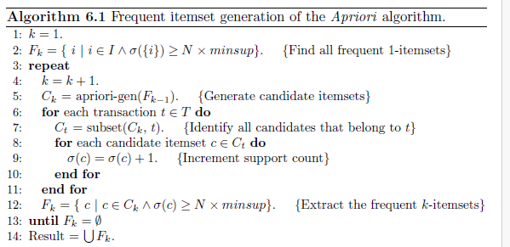
Apriori Algorithm
Notes:
The algorithm initially makes a single pass over the data set to determine
the support of each item. Upon completion of this step, the set of all
frequent 1-itemsets, F1, will be known (steps 1 and 2).
Next, the algorithm will iteratively generate new candidate k-itemsets
using the frequent (k − 1)-itemsets found in the previous iteration (step
5). Candidate generation is implemented using a function called apriorigen,
which is described in Section 6.2.3.
To count the support of the candidates, the algorithm needs to make an
additional pass over the data set (steps 6–10). The subset function is
used to determine all the candidate itemsets in Ck that are contained in
each transaction t. The implementation of this function is described in
Section 6.2.4.
• After counting their supports, the algorithm eliminates all candidate
itemsets whose support counts are less than minsup (step 12).
• The algorithm terminates when there are no new frequent itemsets generated,
i.e., Fk = ∅ (step 13).

Slide 35
Characteristics
The frequent itemset generation part of the Apriori algorithm has two important characteristics.
First, it is a level-wise algorithm; i.e., it traverses the itemset lattice one level at a time, from frequent 1-itemsets to the maximum size of frequent itemsets.
Second, it employs a generate-and-test strategy for finding frequent itemsets. At each iteration, new candidate itemsets are generated from the frequent itemsets found in the previous iteration. The support for each candidate is then counted and tested against the minsup threshold.
The total number of iterations needed by the algorithm is kmax+1, where kmax is the maximum size of the frequent itemsets.

Slide 36
Candidate Generation and Prunning
Candidate Generation. This operation generates new candidate k itemsets based on the frequent (k − 1)-itemsets found in the previous iteration.
Candidate Pruning. This operation eliminates some of the candidate k-itemsets using the support-based pruning strategy.
Notes:
The apriori-gen function shown in Step 5 of Algorithm 6.1 generates candidate
itemsets by performing the following two operations:

Slide 37
Requirements (one)
It should avoid generating too many unnecessary candidates. A candidate itemset is unnecessary if at least one of its subsets is infrequent.
Such a candidate is guaranteed to be infrequent according to the antimonotone property of support.

Slide 38
Requirement (two)
It must ensure that the candidate set is complete, i.e., no frequent itemsets are left out by the candidate generation procedure. To ensure completeness, the set of candidate itemsets must subsume the set of all frequent itemsets, i.e., ∀k : Fk ⊆ Ck.

Slide 39
Requirement (three)
It should not generate the same candidate itemset more than once. For example, the candidate itemset {a, b, c, d} can be generated in many ways—by merging {a, b, c} with {d}, {b, d} with {a, c}, {c} with {a, b, d}, etc. Generation of duplicate candidates leads to wasted computations and thus should be avoided for efficiency reasons.

Slide 40
Candidate Generation: Brute-force method

Slide 41
Candidate Generation: Merge Fk-1 and F1 itemsets
Notes:
This approach, however, does not prevent the same candidate itemset from
being generated more than once. For instance, {Bread, Diapers, Milk} can
be generated by merging {Bread, Diapers} with {Milk}, {Bread, Milk} with
{Diapers}, or {Diapers, Milk} with {Bread}. One way to avoid generating
duplicate candidates is by ensuring that the items in each frequent itemset are
kept sorted in their lexicographic order. Each frequent (k−1)-itemset X is then
extended with frequent items that are lexicographically larger than the items in
X. For example, the itemset {Bread, Diapers} can be augmented with {Milk}
since Milk is lexicographically larger than Bread and Diapers. However, we
should not augment {Diapers, Milk} with {Bread} nor {Bread, Milk} with
{Diapers} because they violate the lexicographic ordering condition.
While this procedure is a substantial improvement over the brute-force
method, it can still produce a large number of unnecessary candidates. For
example, the candidate itemset obtained by merging {Beer, Diapers} with
{Milk} is unnecessary because one of its subsets, {Beer, Milk}, is infrequent.
There are several heuristics available to reduce the number of unnecessary
candidates. For example, note that, for every candidate k-itemset that survives
the pruning step, every item in the candidate must be contained in at least
k −1 of the frequent (k −1)-itemsets. Otherwise, the candidate is guaranteed
to be infrequent. For example, {Beer, Diapers, Milk} is a viable candidate
3-itemset only if every item in the candidate, including Beer, is contained in
at least two frequent 2-itemsets. Since there is only one frequent 2-itemset
containing Beer, all candidate itemsets involving Beer must be infrequent.

Slide 42
Candidate Generation: F_{k-1} x F_{k-1} Method
Merge two frequent (k-1)-itemsets if their first (k-2) items are identical
F₃ = {ABC,ABD,ABE,ACD,BCD,BDE,CDE}
Merge(ABC, ABD) = ABCD
Merge(ABC, ABE) = ABCE
Merge(ABD, ABE) = ABDE
Do not merge(ABD,ACD) because they share only prefix of length 1 instead of length 2

Slide 43
Candidate Pruning
Let F₃ = {ABC,ABD,ABE,ACD,BCD,BDE,CDE} be the set of frequent 3-itemsets
L₄ = {ABCD,ABCE,ABDE} is the set of candidate 4-itemsets generated (from previous slide)
Candidate pruning
Prune ABCE because ACE and BCE are infrequent
Prune ABDE because ADE is infrequent
After candidate pruning: L₄ = {ABCD}

Slide 44
Candidate Generation: Fk-1 x Fk-1 Method

Slide 45
Illustrating Apriori Principle
Items (1-itemsets)
Pairs (2-itemsets)
(No need to generate candidates involving Coke or Eggs)
Minimum Support = 3
Triplets (3-itemsets)
If every subset is considered,
⁶C₁ + ⁶C₂ + ⁶C₃
6 + 15 + 20 = 41
With support-based pruning,
6 + 6 + 1 = 13
Use of F_{k-1}xF_{k-1} method for candidate generation results in
only one 3-itemset. This is eliminated after the support counting step.

Slide 46
Alternate F_{k-1} x F_{k-1} Method
Merge two frequent (k-1)-itemsets if the last (k-2) items of the first one is identical to the first (k-2) items of the second.
F₃ = {ABC,ABD,ABE,ACD,BCD,BDE,CDE}
Merge(ABC, BCD) = ABCD
Merge(ABD, BDE) = ABDE
Merge(ACD, CDE) = ACDE
Merge(BCD, CDE) = BCDE

Slide 47
Candidate Pruning for Alternate F_{k-1} x F_{k-1} Method
Let F₃ = {ABC,ABD,ABE,ACD,BCD,BDE,CDE} be the set of frequent 3-itemsets
L₄ = {ABCD,ABDE,ACDE,BCDE} is the set of candidate 4-itemsets generated (from previous slide)
Candidate pruning
Prune ABDE because ADE is infrequent
Prune ACDE because ACE and ADE are infrequent
Prune BCDE because BCE
After candidate pruning: L₄ = {ABCD}

Slide 48
Support Counting of Candidate Itemsets
Scan the database of transactions to determine the support of each candidate itemset
Must match every candidate itemset against every transaction, which is an expensive operation

Slide 49
Support Counting of Candidate Itemsets
To reduce number of comparisons, store the candidate itemsets in a hash structure
Instead of matching each transaction against every candidate, match it against candidates contained in the hashed buckets

Slide 50
Support Counting: An Example
Suppose you have 15 candidate itemsets of length 3:
{1 4 5}, {1 2 4}, {4 5 7}, {1 2 5}, {4 5 8}, {1 5 9}, {1 3 6}, {2 3 4}, {5 6 7}, {3 4 5}, {3 5 6}, {3 5 7}, {6 8 9}, {3 6 7}, {3 6 8}
How many of these itemsets are supported by transaction (1,2,3,5,6)?

Slide 51
Support Counting Using a Hash Tree
Suppose you have 15 candidate itemsets of length 3:
{1 4 5}, {1 2 4}, {4 5 7}, {1 2 5}, {4 5 8}, {1 5 9}, {1 3 6}, {2 3 4}, {5 6 7}, {3 4 5}, {3 5 6}, {3 5 7}, {6 8 9}, {3 6 7}, {3 6 8}
You need:
Hash function
Max leaf size: max number of itemsets stored in a leaf node (if number of candidate itemsets exceeds max leaf size, split the node)
Hash function
2 3 4
5 6 7
3,6,9
1,4,7
1 4 5
3 4 5
3 5 6
3 5 7
6 8 9
3 6 7
3 6 8
1 3 6
2,5,8
1 2 4
4 5 7
1 2 5
4 5 8
1 5 9

Slide 52
Support Counting Using a Hash Tree
Hash Function
Candidate Hash Tree
1,4,7
3,6,9
2,5,8
2 3 4
5 6 7
1 4 5
1 3 6
3 4 5
3 5 6
3 6 7
Hash on 1, 4 or 7
3 5 7
3 6 8
1 2 4
1 5 9
6 8 9
1 2 5
4 5 7
4 5 8

Slide 53
Support Counting Using a Hash Tree
Hash Function
Candidate Hash Tree
1,4,7
3,6,9
2,5,8
2 3 4
5 6 7
1 4 5
1 3 6
3 4 5
3 5 6
3 6 7
Hash on 2, 5 or 8
3 5 7
3 6 8
1 2 4
1 5 9
6 8 9
1 2 5
4 5 7
4 5 8

Slide 54
Support Counting Using a Hash Tree
Hash Function
Candidate Hash Tree
1,4,7
3,6,9
2,5,8
2 3 4
5 6 7
1 4 5
1 3 6
3 4 5
3 5 6
3 6 7
Hash on 3, 6 or 9
3 5 7
3 6 8
1 2 4
1 5 9
6 8 9
1 2 5
4 5 7
4 5 8

Slide 55
Support Counting Using a Hash Tree
1 2 3 5 6
transaction
Hash Function
1 +
2 3 5 6
2 +
3 5 6
1,4,7
3,6,9
3 +
5 6
2,5,8
2 3 4
5 6 7
1 4 5
1 3 6
3 4 5
3 5 6
3 6 7
3 5 7
3 6 8
1 2 4
1 2 5
1 5 9
6 8 9
4 5 7
4 5 8

Slide 56
Support Counting Using a Hash Tree
1 2 3 5 6
transaction
Hash Function
1 +
2 3 5 6
2 +
3 5 6
1,4,7
3,6,9
1 2 +
3 5 6
3 +
5 6
2,5,8
1 3 +
5 6
2 3 4
1 5 +
6
5 6 7
1 4 5
1 3 6
3 4 5
3 5 6
3 6 7
3 5 7
3 6 8
1 2 4
1 2 5
1 5 9
6 8 9
4 5 7
4 5 8

Slide 57
Support Counting Using a Hash Tree
1 2 3 5 6
transaction
Hash Function
1 +
2 3 5 6
2 +
3 5 6
1,4,7
3,6,9
1 2 +
3 5 6
3 +
5 6
2,5,8
1 3 +
5 6
2 3 4
1 5 +
6
5 6 7
1 4 5
1 3 6
3 4 5
3 5 6
3 6 7
3 5 7
3 6 8
1 2 4
1 2 5
1 5 9
6 8 9
4 5 7
4 5 8
Match transaction against 11 out of 15 candidates

Slide 58
Rule Generation
Given a frequent itemset L, find all non-empty subsets f ⊂ L such that f → L – f satisfies the minimum confidence requirement
If {A,B,C,D} is a frequent itemset, candidate rules:
ABC →D, ABD →C, ACD →B, BCD →A, A →BCD, B →ACD, C →ABD, D →ABC AB →CD, AC → BD, AD → BC, BC →AD, BD →AC, CD →AB,
If |L| = k, then there are 2^{k} – 2 candidate association rules (ignoring L → ∅ and ∅ → L)

Slide 59
Rule Generation
In general, confidence does not have an anti-monotone property
c(ABC →D) can be larger or smaller than c(AB →D)
But confidence of rules generated from the same itemset has an anti-monotone property
E.g., Suppose {A,B,C,D} is a frequent 4-itemset: c(ABC → D) ≥ c(AB → CD) ≥ c(A → BCD)
Confidence is anti-monotone w.r.t. number of items on the RHS of the rule

Slide 60
Rule Generation for Apriori Algorithm
Lattice of rules
Low Confidence Rule
Pruned Rules

